Slide 1
CSCI 4110 Mathematics Background
Mark Green
Faculty of Science
UOIT

Slide 2
Introduction
There are two areas of mathematics that are useful in this course:
Linear algebra
Calculus
The linear algebra background is covered nicely in chapter 7 of the Foley et.al. and you should be familiar with most of it from a previous graphics course
That leaves us with calculus, which I’m sure thrills you
We need calculus as a notation, a way of describing things
We will not be doing mathematics, trust that the mathematicians have done that right

Slide 3
Calculus
There are two types of calculus:
Differential
Integral
We will start with differential calculus
Historically calculus was developed to describe motion, the motion of planets and other bodies
Differential calculus is all about rates of change, how fast something is changing
Think about velocity and position, velocity is the rate at which position is changing

Slide 4
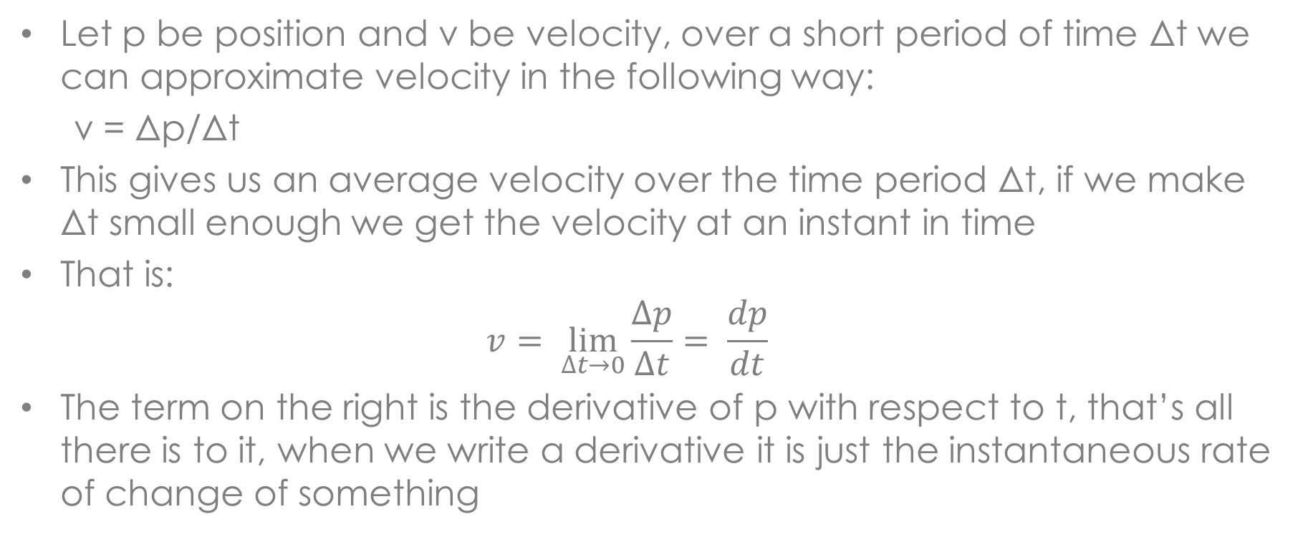
Differential Calculus
Let p be position and v be velocity, over a short period of time Δt we can approximate velocity in the following way:
v = Δp/Δt
This gives us an average velocity over the time period Δt, if we make Δt small enough we get the velocity at an instant in time
That is:
$$v= \lim_{∆t→0}{\frac{∆p}{∆t}}= \frac{dp}{dt}$$
The term on the right is the derivative of p with respect to t, that’s all there is to it, when we write a derivative it is just the instantaneous rate of change of something

Slide 5
Differential Calculus
In computers we can’t have real derivatives, we need to approximate them
Our previous discussion tells us how we can do that
If we have a small enough time interval, divide the change in position by the change in time, and that’s an approximation to the velocity
We need to remember that this is an approximation, there will be an error associated with it, so we need to be careful
We can take the derivative with respect to any variable
Example: the derivative of y with respect to x is the slope or tangent to a curve

Slide 6
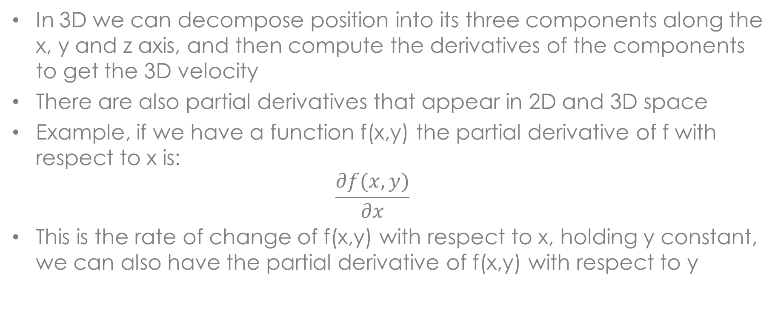
Differential Calculus
In 3D we can decompose position into its three components along the x, y and z axis, and then compute the derivatives of the components to get the 3D velocity
There are also partial derivatives that appear in 2D and 3D space
Example, if we have a function f(x,y) the partial derivative of f with respect to x is:
$$\frac{∂f(x,y)}{∂x}$$
This is the rate of change of f(x,y) with respect to x, holding y constant, we can also have the partial derivative of f(x,y) with respect to y

Slide 7
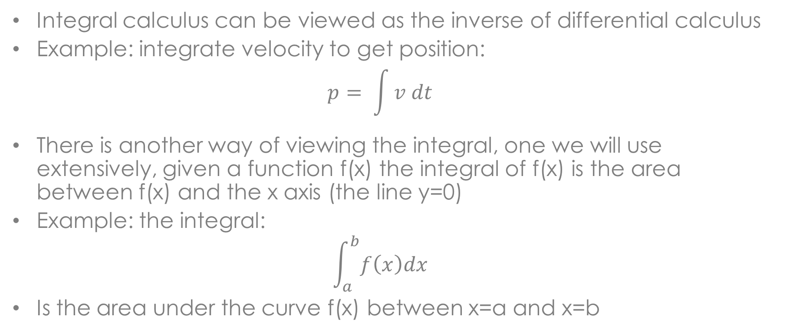
Integral Calculus
Integral calculus can be viewed as the inverse of differential calculus
Example: integrate velocity to get position:
$$p= \int{v dt}$$
There is another way of viewing the integral, one we will use extensively, given a function f(x) the integral of f(x) is the area between f(x) and the x axis (the line y=0)
Example: the integral:
$$\int_{a}^{b}{f\left(x\right)dx}$$
Is the area under the curve f(x) between x=a and x=b

Slide 8
Integral Calculus
The area interpretation is very important for us
We want to compute light intensity over a small patch of an object, or over the hemisphere above an object
Again, we cannot represent an integral exactly within a computer
One way of viewing it is:
Δp = Δv Δt
As we move along in time we can compute p in the following way:
p’ = p + Δv Δt
Later we will examine a more advanced approach called Monte Carlo integration

Slide 9
Summary
Remember the physical interpretation of the derivative and integral, this helps a lot with understanding the mathematics
Will examine ways of computing them during the course, we are interested in the algorithms and computations, the mathematics is secondary

